Slide 1
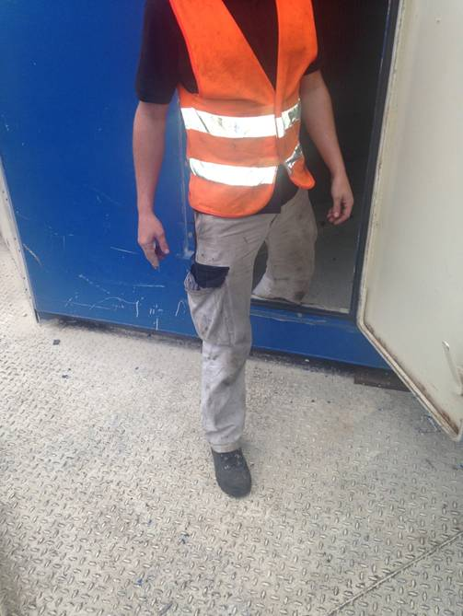
HS&E INCIDENT BULLETIN |  | 3rd Quarter 2013
Slovakia | Type of incident Slipping & falling, finger fracture
Summary: | Photograph for illustration purposes only
The individual left the suction chamber. He slipped, while trying to catch his fall he suffered a fracture of his right index finger.
Root Causes: | Actions Taken Thus Far: Next Steps
Wet floor due to light rain. | Inform Field Service Engineers to increase awareness of such trip hazards.

